Slide 1
Understanding Deep Neural Networks
Tutorial
Convolutional Neural Networks

Slide 2
Outline
CNNs’ Motivation
CNNs’ Components
CNNs’ Structure
CNNs’ Learning
CNNs’ Application

Slide 3
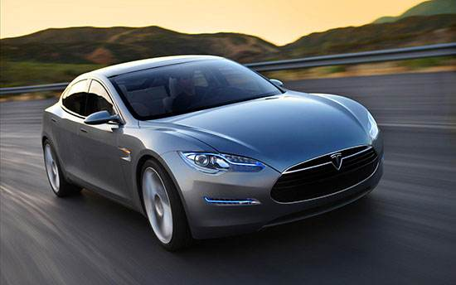
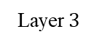
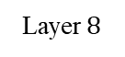
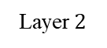
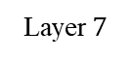
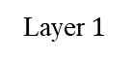
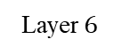
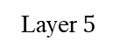
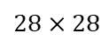
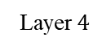
CNN’s Motivation
How to handle the very large colorful image in the size of 224x224x3, where the 3 denotes the R,G,B channels.
$$28×28$$
784-dimension
224x224x3
Layer$1$
Layer$2$
Layer$3$
Layer$4$
Layer$5$
Layer$6$
Layer$7$
Layer$8$
Notes:
删掉箭头

Slide 4
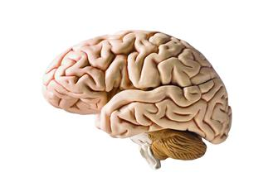
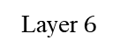
CNN’s Motivation
Suppose the dimension of hidden layer is 100. The number of parameters in the first layer is 15,052,800, unacceptable !
How does the brain process the image?
224x224x3
150,528-dimension
Layer$1$
Layer$2$
Layer$3$
Layer$4$
Layer$5$
Layer$6$
Layer$7$
Layer$8$

Slide 5
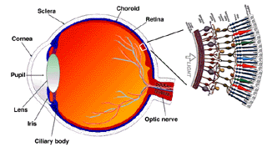
CNN’s Motivation
Each neuron can only perceive a sub-region in the image.
The sub-region is called receptive field.
V1
V4
V2
IT
Neuron
Retina
Neuron

Slide 6
CNN’s Motivation
Receptive field of neurons in V1
Receptive field of neurons in V2
V1
V4
V2
IT
Receptive field of neurons in V4
Question:
How to build the model of receptive field?

Slide 7
Outline
CNNs’ Motivation
CNNs’ Components
CNNs’ Structure
CNNs’ Learning
CNNs’ Application

Slide 8
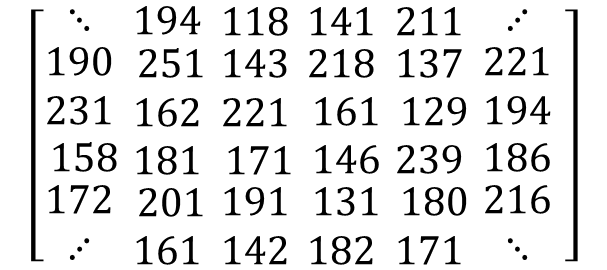
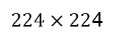
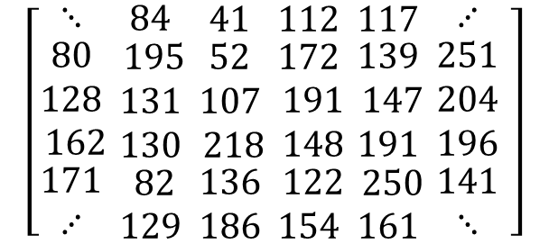
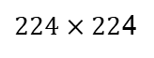
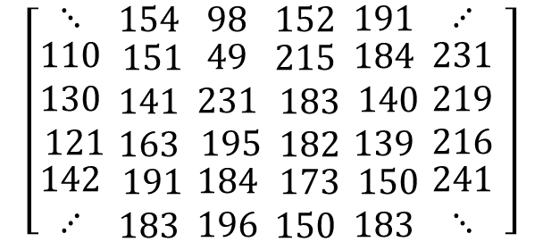
CNN’s Components
$$\left[\begin{matrix}⋱ \\ \begin{aligned}110 \\ 130 \\ 121 \end{aligned} \\ \begin{aligned}142 \\ ⋰ \end{aligned}\end{matrix}\begin{matrix}154 \\ \begin{aligned}151 \\ 141 \\ 163 \end{aligned} \\ \begin{aligned}191 \\ 183 \end{aligned}\end{matrix}\begin{matrix}98 \\ \begin{aligned}49 \\ 231 \\ 195 \end{aligned} \\ \begin{aligned}184 \\ 196 \end{aligned}\end{matrix}\begin{matrix}152 \\ \begin{aligned}215 \\ 183 \\ 182 \end{aligned} \\ \begin{aligned}173 \\ 150 \end{aligned}\end{matrix}\begin{matrix}191 \\ \begin{aligned}184 \\ 140 \\ 139 \end{aligned} \\ \begin{aligned}150 \\ 183 \end{aligned}\end{matrix}\begin{matrix}⋰ \\ \begin{aligned}231 \\ 219 \\ 216\end{aligned} \\ \begin{aligned}241 \\ ⋱\end{aligned}\end{matrix} \right]$$
Channel R, 224x224x1
$224×22$4
$$\left[\begin{matrix}⋱ \\ \begin{aligned}80 \\ 128 \\ 162 \end{aligned} \\ \begin{aligned}171 \\ ⋰ \end{aligned}\end{matrix}\begin{matrix}84 \\ \begin{aligned}195 \\ 131 \\ 130 \end{aligned} \\ \begin{aligned}82 \\ 129 \end{aligned}\end{matrix}\begin{matrix}41 \\ \begin{aligned}52 \\ 107 \\ 218 \end{aligned} \\ \begin{aligned}136 \\ 186 \end{aligned}\end{matrix}\begin{matrix}112 \\ \begin{aligned}172 \\ 191 \\ 148 \end{aligned} \\ \begin{aligned}122 \\ 154 \end{aligned}\end{matrix}\begin{matrix}117 \\ \begin{aligned}139 \\ 147 \\ 191 \end{aligned} \\ \begin{aligned}250 \\ 161 \end{aligned}\end{matrix}\begin{matrix}⋰ \\ \begin{aligned}251 \\ 204 \\ 196\end{aligned} \\ \begin{aligned}141 \\ ⋱\end{aligned}\end{matrix} \right]$$
$224×22$4
224x224x3
Channel G, 224x224x1
$$\left[\begin{matrix}⋱ \\ \begin{aligned}190 \\ 231 \\ 158 \end{aligned} \\ \begin{aligned}172 \\ ⋰ \end{aligned}\end{matrix}\begin{matrix}194 \\ \begin{aligned}251 \\ 162 \\ 181 \end{aligned} \\ \begin{aligned}201 \\ 161 \end{aligned}\end{matrix}\begin{matrix}118 \\ \begin{aligned}143 \\ 221 \\ 171 \end{aligned} \\ \begin{aligned}191 \\ 142 \end{aligned}\end{matrix}\begin{matrix}141 \\ \begin{aligned}218 \\ 161 \\ 146 \end{aligned} \\ \begin{aligned}131 \\ 182 \end{aligned}\end{matrix}\begin{matrix}211 \\ \begin{aligned}137 \\ 129 \\ 239 \end{aligned} \\ \begin{aligned}180 \\ 171 \end{aligned}\end{matrix}\begin{matrix}⋰ \\ \begin{aligned}221 \\ 194 \\ 186\end{aligned} \\ \begin{aligned}216 \\ ⋱\end{aligned}\end{matrix} \right]$$
Channel B, 224x224x1
$224×22$4

Slide 9
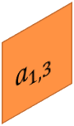
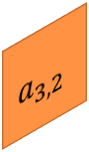
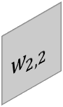
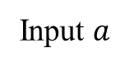

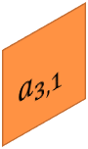
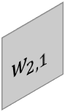

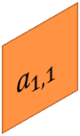

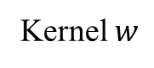
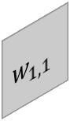

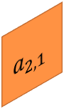

CNN’s Components
Kernel $w$
Input $a$
$$a_{1,3}^{}$$
Kernel is a small matrix used to process image.
The size of the kernel is equivalent to the receptive field.
$$a_{1,2}^{}$$
$$w_{1,2}^{}$$
$$a_{1,1}^{}$$
$$a_{2,3}^{}$$
$$w_{1,1}^{}$$
$$a_{2,2}^{}$$
$$w_{2,2}^{}$$
$$a_{2,1}^{}$$
$$a_{3,3}^{}$$
$$w_{2,1}^{}$$
$$a_{3,2}^{}$$
$$a_{3,1}^{}$$

Slide 10

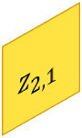

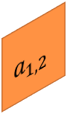
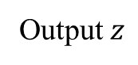
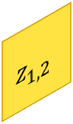


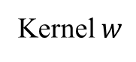



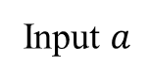


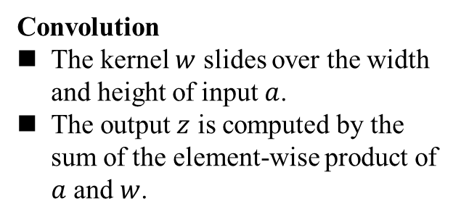
CNN’s Components
$$a_{1,3}^{}$$
Convolution
The kernel $w$ slides over the width and height of input $a$.
The output $z$ is computed by the sum of the element-wise product of $a$ and $w$.
$$a_{1,2}^{}$$
$$w_{1,2}^{}$$
$$z_{1,2}^{}$$
$$a_{1,1}^{}$$
$$a_{2,3}^{}$$
$$w_{1,1}^{}$$
$$z_{1,1}^{}$$
$$a_{2,2}^{}$$
$$w_{2,2}^{}$$
$$z_{2,2}^{}$$
$$a_{2,1}^{}$$
$$a_{3,3}^{}$$
$$w_{2,1}^{}$$
$$z_{2,1}^{}$$
$$a_{3,2}^{}$$
$$a_{3,1}^{}$$
Input $a$
Kernel $w$
Output $z$

Slide 11
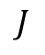

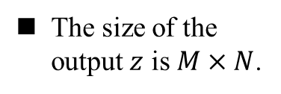
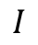

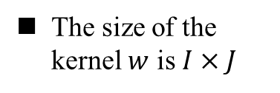

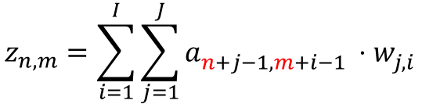

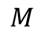
CNN’s Components
$$a_{1,3}^{}$$
$$a_{1,2}^{}$$
$$w_{1,2}^{}$$
$$z_{1,2}^{}$$
$$a_{1,1}^{}$$
$$a_{2,3}^{}$$
$$w_{1,1}^{}$$
$$J$$
$$z_{1,1}^{}$$
$$z_{n,m}^{}=\sum_{i=1}^{I}{\sum_{j=1}^{J}{a_{n+j−1, m+i−1 }^{}⋅w_{j,i}^{}}}$$
$$N$$
$$a_{2,2}^{}$$
$$w_{2,2}^{}$$
$$z_{2,2}^{}$$
$$a_{2,1}^{}$$
$$a_{3,3}^{}$$
$$w_{2,1}^{}$$
$$z_{2,1}^{}$$
$$a_{3,2}^{}$$
$$a_{3,1}^{}$$
$$I$$
$$M$$
The size of the kernel $w$ is $I×J$
The size of the output $z$ is $M×N$.

Slide 12
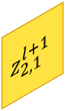
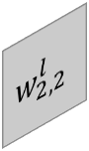
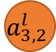
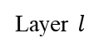
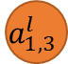
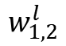
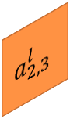
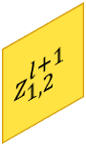
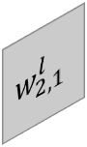






























CNN’s Components
$$a_{1,1}^{l}$$
$$w_{1,1}^{l}$$
$$a_{1,2}^{l}$$
$$w_{1,2}^{l}$$
$$a_{1,3}^{l}$$
$$a_{1,3}^{l}$$
$$a_{1,2}^{l}$$
$$w_{1,2}^{l}$$
$$z_{1,2}^{l+1}$$
$$z_{1,1}^{l+1}$$
$$a_{2,1}^{l}$$
$$w_{2,1}^{l}$$
$$a_{1,1}^{l}$$
$$a_{2,3}^{l}$$
$$w_{1,1}^{l}$$
$$z_{1,1}^{l+1}$$
Local connected
$$w_{2,2}^{l}$$
$$z_{1,2}^{l+1}$$
$$a_{2,2}^{l}$$
$$w_{2,2}^{l}$$
$$z_{2,2}^{l+1}$$
$$a_{2,2}^{l}$$
$$a_{2,1}^{l}$$
$$a_{3,3}^{l}$$
$$w_{2,1}^{l}$$
$$z_{2,1}^{l+1}$$
$$a_{3,2}^{l}$$
$$a_{2,3}^{l}$$
$$a_{3,1}^{l}$$
$$z_{2,1}^{l+1}$$
$$a_{3,1}^{l}$$
Layer $l$
Layer $l+1$
$$z_{2,2}^{l+1}$$
$$a_{3,2}^{l}$$
$$z_{n,m}^{l+1}=\sum_{i=1}^{I}{\sum_{j=1}^{J}{a_{n+j−1, m+i−1 }^{l}⋅w_{j,i}^{l}}}$$
$$a_{3,3}^{l}$$
Layer $l$
Layer $l+1$
Each summation is equivalent to the local connected forward computation.
The kernel is shared in each receptive field.

Slide 13




























CNN’s Components
$$a_{1,1}^{l}$$
$$a_{1,2}^{l}$$
$$a_{1,3}^{l}$$
$$z_{1,1}^{l+1}$$
$$a_{1,3}^{l}$$
$$a_{2,1}^{l}$$
$$a_{1,2}^{l}$$
$$w_{1,2}^{l}$$
$$z_{1,2}^{l+1}$$
$$z_{1,2}^{l+1}$$
$$a_{1,1}^{l}$$
$$a_{2,3}^{l}$$
$$w_{1,1}^{l}$$
$$z_{1,1}^{l+1}$$
$$a_{2,2}^{l}$$
$$a_{2,2}^{l}$$
$$w_{2,2}^{l}$$
$$z_{2,2}^{l+1}$$
$$a_{2,3}^{l}$$
$$a_{2,1}^{l}$$
$$a_{3,3}^{l}$$
$$w_{2,1}^{l}$$
$$z_{2,1}^{l+1}$$
$$z_{2,1}^{l+1}$$
$$a_{3,2}^{l}$$
$$a_{3,1}^{l}$$
$$a_{3,1}^{l}$$
$$z_{2,2}^{l+1}$$
$$a_{3,2}^{l}$$
$$a_{3,3}^{l}$$
$$a^{l}∈R^{9}$$
$$z^{l+1}∈R^{4}$$
The number of parameters in convolution is equal to the size of the kernel, which is $2×2$ in this case. Much smaller than the fully-connected layer!
The number of parameters in fully-connected layer is $9×4=36$.

Slide 14







CNN’s Components
$$a_{1,3}^{l}$$
$$a_{1,2}^{l}$$
$$w_{1,2}^{l}$$
$$z_{1,2}^{l+1}$$
$$a_{1,1}^{l}$$
$$a_{2,3}^{l}$$
$$w_{1,1}^{l}$$
$$z_{1,1}^{l+1}$$
$$a_{2,2}^{l}$$
$$w_{2,2}^{l}$$
$$z_{2,2}^{l+1}$$
$$a_{2,1}^{l}$$
$$a_{3,3}^{l}$$
$$w_{2,1}^{l}$$
$$z_{2,1}^{l+1}$$
$$a_{3,2}^{l}$$
$$a_{3,1}^{l}$$
How to process the input composed of multiple channels?

Slide 15























































CNN’s Components
$$a_{1,3}^{l}$$
$$a_{1,2}^{l}$$
$$a_{2,3}^{l}$$
$$w_{1,2}^{l}$$
$$z_{1,2}^{l+1}$$
$$a_{1,1}^{l}$$
$$a_{2,2}^{l}$$
$$w_{1,1}^{l}$$
$$w_{2,2}^{l}$$
$$z_{1,1}^{l+1}$$
$$z_{2,2}^{l+1}$$
$$a_{2,1}^{l}$$
$$a_{3,3}^{l}$$
$$w_{2,1}^{l}$$
$$z_{2,1}^{l+1}$$
$$a_{3,2}^{l}$$
$$a_{3,1}^{l}$$
Step 1: Convolve the R, G, B channels independently.
Step 2: Sum the output of each convolution.
$$a_{1,3}^{l}$$
Sum
$$z_{1,2}^{l+1}$$
$$a_{1,2}^{l}$$
$$a_{2,3}^{l}$$
$$w_{1,2}^{l}$$
$$z_{1,2}^{l+1}$$
$$z_{1,1}^{l+1}$$
$$a_{1,1}^{l}$$
$$a_{2,2}^{l}$$
$$w_{1,1}^{l}$$
$$w_{2,2}^{l}$$
$$z_{1,1}^{l+1}$$
$$z_{2,2}^{l+1}$$
$$z_{2,2}^{l+1}$$
$$a_{2,1}^{l}$$
$$a_{3,3}^{l}$$
$$w_{2,1}^{l}$$
$$z_{2,1}^{l+1}$$
$$z_{2,1}^{l+1}$$
$$a_{3,2}^{l}$$
$$a_{3,1}^{l}$$
$$a_{1,3}^{l}$$
$$a_{1,2}^{l}$$
$$a_{2,3}^{l}$$
$$w_{1,2}^{l}$$
$$z_{1,2}^{l+1}$$
$$a_{1,1}^{l}$$
$$a_{2,2}^{l}$$
$$w_{1,1}^{l}$$
$$w_{2,2}^{l}$$
$$z_{1,1}^{l+1}$$
$$z_{2,2}^{l+1}$$
$$a_{2,1}^{l}$$
$$a_{3,3}^{l}$$
$$w_{2,1}^{l}$$
$$z_{2,1}^{l+1}$$
$$a_{3,2}^{l}$$
$$a_{3,1}^{l}$$

Slide 16














































CNN’s Components
$$a_{1,3}^{l}$$
$$a_{1,2}^{l}$$
$$a_{2,3}^{l}$$
$$w_{1,2}^{l}$$
$$z_{1,2}^{l+1}$$
$$a_{1,1}^{l}$$
$$a_{2,2}^{l}$$
$$w_{1,1}^{l}$$
$$w_{2,2}^{l}$$
$$z_{1,1}^{l+1}$$
$$z_{2,2}^{l+1}$$
$$a_{2,1}^{l}$$
$$a_{3,3}^{l}$$
$$w_{2,1}^{l}$$
$$z_{2,1}^{l+1}$$
$$a_{3,2}^{l}$$
$$a_{3,1}^{l}$$
$$a_{1,3}^{l}$$
Sum
$$z_{1,2}^{l+1}$$
$$a_{1,2}^{l}$$
$$w_{1,2}^{l}$$
$$z_{1,2}^{l+1}$$
$$z_{1,1}^{l+1}$$
$$z_{2,2}^{l+1}$$
$$a_{1,1}^{l}$$
$$a_{2,3}^{l}$$
$$w_{1,1}^{l}$$
$$z_{1,1}^{l+1}$$
$$a_{2,2}^{l}$$
$$w_{2,2}^{l}$$
$$z_{2,2}^{l+1}$$
$$z_{2,1}^{l+1}$$
$$a_{2,1}^{l}$$
$$a_{3,3}^{l}$$
$$w_{2,1}^{l}$$
$$z_{2,1}^{l+1}$$
Channel-wise version
$$a_{3,2}^{l}$$
$$a_{3,1}^{l}$$
$$a_{1,3}^{l}$$
$$a_{1,2}^{l}$$
$$a_{2,3}^{l}$$
$$w_{1,2}^{l}$$
$$z_{1,2}^{l+1}$$
$$a_{1,1}^{l}$$
$$a_{2,2}^{l}$$
$$w_{1,1}^{l}$$
$$w_{2,2}^{l}$$
$$z_{1,1}^{l+1}$$
$$z_{2,2}^{l+1}$$
$$a_{2,1}^{l}$$
$$a_{3,3}^{l}$$
$$w_{2,1}^{l}$$
$$z_{2,1}^{l+1}$$
$$a_{3,2}^{l}$$
$$a_{3,1}^{l}$$
How to get the output with multiple channels?
Stacked version

Slide 17
CNN’s Components
Convolution
Kernel 1
Stack
Step 1: Use multiple kernels to convolve the input.
Step 2: Stack the output of each convolution. The number of kernels is equal to the output channel.
Convolution
K channels
Kernel 2
Output new image
Convolution
…
Input image
Kernel K

Slide 18












































CNN’s Components
$$a_{1,5}^{l}$$
$$a_{1,4}^{l}$$
$$a_{1,3}^{l}$$
$$a_{2,5}^{l}$$
$$w_{1,3}^{l}$$
$$z_{1,3}^{l+1}$$
$$a_{1,2}^{l}$$
$$a_{2,4}^{l}$$
$$w_{1,2}^{l}$$
$$z_{1,2}^{l+1}$$
$$a_{1,1}^{l}$$
$$a_{2,3}^{l}$$
$$a_{3,5}^{l}$$
$$w_{1,1}^{l}$$
$$w_{2,3}^{l}$$
$$z_{1,1}^{l+1}$$
$$z_{2,3}^{l+1}$$
For notational simplicity, we will use the input with a single channel to demonstrate the components of CNNs.
$$a_{2,2}^{l}$$
$$a_{3,4}^{l}$$
$$w_{2,2}^{l}$$
$$z_{2,2}^{l+1}$$
$$a_{2,1}^{l}$$
$$a_{3,3}^{l}$$
$$a_{4,5}^{l}$$
$$w_{2,1}^{l}$$
$$w_{3,3}^{l}$$
$$z_{2,1}^{l+1}$$
$$z_{3,3}^{l+1}$$
$$a_{3,2}^{l}$$
$$a_{4,4}^{l}$$
$$w_{3,2}^{l}$$
$$z_{3,2}^{l+1}$$
$$a_{3,1}^{l}$$
$$a_{4,3}^{l}$$
$$a_{5,5}^{l}$$
$$w_{3,1}^{l}$$
$$z_{3,1}^{l+1}$$
$$a_{4,2}^{l}$$
$$a_{5,4}^{l}$$
$$a_{4,1}^{l}$$
$$a_{5,3}^{l}$$
$$a_{5,2}^{l}$$
$$a_{5,1}^{l}$$
$$z_{n,m}^{l+1}=\sum_{i=1}^{I}{\sum_{j=1}^{J}{a_{n+j−1, m+i−1 }^{l}⋅w_{j,i}^{l}}}$$

Slide 19

























CNN’s Components
Stride is 1
Stride is 2
$$a_{1,5}^{l}$$
$$a_{1,5}^{l}$$
$$a_{1,4}^{l}$$
$$a_{1,4}^{l}$$
$$a_{1,3}^{l}$$
$$a_{2,5}^{l}$$
$$w_{1,3}^{l}$$
$$z_{1,3}^{l+1}$$
$$a_{1,3}^{l}$$
$$a_{2,5}^{l}$$
$$w_{1,3}^{l}$$
$$z_{1,2}^{l+1}$$
$$a_{1,2}^{l}$$
$$a_{2,4}^{l}$$
$$w_{1,2}^{l}$$
$$z_{1,2}^{l+1}$$
$$a_{1,2}^{l}$$
$$a_{2,4}^{l}$$
$$w_{1,2}^{l}$$
$$a_{1,1}^{l}$$
$$a_{2,3}^{l}$$
$$a_{3,5}^{l}$$
$$w_{1,1}^{l}$$
$$w_{2,3}^{l}$$
$$z_{1,1}^{l+1}$$
$$z_{2,3}^{l+1}$$
$$a_{1,1}^{l}$$
$$a_{2,3}^{l}$$
$$a_{3,5}^{l}$$
$$w_{1,1}^{l}$$
$$w_{2,3}^{l}$$
$$z_{1,1}^{l+1}$$
$$a_{2,2}^{l}$$
$$a_{3,4}^{l}$$
$$w_{2,2}^{l}$$
$$z_{2,2}^{l+1}$$
$$a_{2,2}^{l}$$
$$a_{3,4}^{l}$$
$$w_{2,2}^{l}$$
$$a_{2,1}^{l}$$
$$a_{3,3}^{l}$$
$$a_{4,5}^{l}$$
$$w_{2,1}^{l}$$
$$w_{3,3}^{l}$$
$$z_{2,1}^{l+1}$$
$$z_{3,3}^{l+1}$$
$$a_{2,1}^{l}$$
$$a_{3,3}^{l}$$
$$a_{4,5}^{l}$$
$$w_{2,1}^{l}$$
$$w_{3,3}^{l}$$
$$z_{2,2}^{l+1}$$
$$a_{3,2}^{l}$$
$$a_{4,4}^{l}$$
$$w_{3,2}^{l}$$
$$z_{3,2}^{l+1}$$
$$a_{3,2}^{l}$$
$$a_{4,4}^{l}$$
$$w_{3,2}^{l}$$
$$z_{2,1}^{l+1}$$
$$a_{3,1}^{l}$$
$$a_{4,3}^{l}$$
$$a_{5,5}^{l}$$
$$w_{3,1}^{l}$$
$$z_{3,1}^{l+1}$$
$$a_{3,1}^{l}$$
$$a_{4,3}^{l}$$
$$a_{5,5}^{l}$$
$$w_{3,1}^{l}$$
$$a_{4,2}^{l}$$
$$a_{5,4}^{l}$$
$$a_{4,2}^{l}$$
$$a_{5,4}^{l}$$
$$a_{4,1}^{l}$$
$$a_{5,3}^{l}$$
$$a_{4,1}^{l}$$
$$a_{5,3}^{l}$$
$$a_{5,2}^{l}$$
$$a_{5,2}^{l}$$
$$a_{5,1}^{l}$$
$$a_{5,1}^{l}$$
Stride controls the step of kernel.
Note that the size of the output is smaller than the input, even when the stride is 1.
How to keep the size of output the same with that of input, to construct very deep CNNs?

Slide 20






































CNN’s Components
Stride is 1
$$0$$
$$0$$
$$z_{1,5}^{l+1}$$
$$0$$
$$0$$
$$z_{1,4}^{l+1}$$
$$0$$
$$a_{1,5}^{l}$$
$$z_{1,3}^{l+1}$$
$$z_{2,5}^{l+1}$$
$$a_{1,5}^{l}$$
$$0$$
$$a_{1,4}^{l}$$
$$0$$
$$w_{1,3}^{l}$$
$$z_{1,2}^{l+1}$$
$$z_{2,4}^{l+1}$$
$$a_{1,4}^{l}$$
$$0$$
$$a_{1,3}^{l}$$
$$a_{2,5}^{l}$$
$$w_{1,2}^{l}$$
$$z_{1,1}^{l+1}$$
$$z_{2,3}^{l+1}$$
$$z_{3,5}^{l+1}$$
$$a_{1,3}^{l}$$
$$a_{2,5}^{l}$$
$$0$$
$$a_{1,2}^{l}$$
$$a_{2,4}^{l}$$
$$0$$
$$w_{1,1}^{l}$$
$$w_{2,3}^{l}$$
$$z_{2,2}^{l+1}$$
$$z_{3,4}^{l+1}$$
$$a_{1,2}^{l}$$
$$a_{2,4}^{l}$$
$$a_{1,1}^{l}$$
$$a_{2,3}^{l}$$
$$a_{3,5}^{l}$$
$$w_{2,2}^{l}$$
$$z_{2,1}^{l+1}$$
$$z_{3,3}^{l+1}$$
$$z_{4,5}^{l+1}$$
$$a_{1,1}^{l}$$
$$a_{2,3}^{l}$$
$$a_{3,5}^{l}$$
Padding with 0
$$0$$
$$a_{2,2}^{l}$$
$$a_{3,4}^{l}$$
$$0$$
$$w_{2,1}^{l}$$
$$w_{3,3}^{l}$$
$$z_{3,2}^{l+1}$$
$$z_{4,4}^{l+1}$$
$$a_{2,2}^{l}$$
$$a_{3,4}^{l}$$
$$a_{2,1}^{l}$$
$$a_{3,3}^{l}$$
$$a_{4,5}^{l}$$
$$w_{3,2}^{l}$$
$$z_{3,1}^{l+1}$$
$$z_{4,3}^{l+1}$$
$$z_{5,5}^{l+1}$$
$$a_{2,1}^{l}$$
$$a_{3,3}^{l}$$
$$a_{4,5}^{l}$$
$$0$$
$$a_{3,2}^{l}$$
$$a_{4,4}^{l}$$
$$0$$
$$w_{3,1}^{l}$$
$$z_{4,2}^{l+1}$$
$$z_{5,4}^{l+1}$$
$$a_{3,2}^{l}$$
$$a_{4,4}^{l}$$
$$a_{3,1}^{l}$$
$$a_{4,3}^{l}$$
$$a_{5,5}^{l}$$
$$z_{4,1}^{l+1}$$
$$z_{5,3}^{l+1}$$
$$a_{3,1}^{l}$$
$$a_{4,3}^{l}$$
$$a_{5,5}^{l}$$
$$0$$
$$a_{4,2}^{l}$$
$$a_{5,4}^{l}$$
$$0$$
$$z_{5,2}^{l+1}$$
$$a_{4,2}^{l}$$
$$a_{5,4}^{l}$$
$$a_{4,1}^{l}$$
$$a_{5,3}^{l}$$
$$0$$
$$z_{5,1}^{l+1}$$
$$a_{4,1}^{l}$$
$$a_{5,3}^{l}$$
$$0$$
$$a_{5,2}^{l}$$
$$0$$
$$a_{5,2}^{l}$$
$$a_{5,1}^{l}$$
$$0$$
$$a_{5,1}^{l}$$
$$0$$
$$0$$
$$0$$
$$0$$
Padding the input with a certain number of zeros will keep the size of the output unchanged.
We can downsample the input by using convolution with stride > 1. This is at the cost of introducing more parameter $w$.
Is there an efficient way to downsample the input?

Slide 21

CNN’s Components
5
1
Max pooling
5
3
4
6
3
2
4
4
0
7
6
1
3
3
0
4
2
7
Pooling
5
1
Average pooling
3
3
4
4
3
2
2
4
0
3
6
1
3
3
0
4
2
7
Pooling aims to reduce the size of input efficiently, without introduce parameters $w$.
Max pooling computes the max value in the receptive field.
Average pooling computes the average value in the receptive field.

Slide 22




CNN’s Components
Stride is 2
5
1
Max pooling
5
3
4
6
3
2
4
4
0
7
6
1
3
3
0
4
2
7
Padding with 0
$$0$$
5
$$0$$
$$0$$
1
$$0$$
3
Average pooling
3
$$0$$
$$0$$
4
4
$$0$$
3
2
2
$$0$$
$$0$$
4
0
3
$$0$$
$$0$$
6
1
$$0$$
3
3
$$0$$
0
4
$$0$$
$$=$$
$$0$$
2
$$0$$
$$0$$
7
$$0$$
$$0$$
$$0$$
$$0$$
$$0$$
$$0$$
$$0$$

Slide 23





The Effectiveness of Kernel
Raw image
Edge detected by $w1$
Blurred by $w2$
$$w1= \left[\begin{matrix}−1 & −1 & −1 \\ −1 & 8 & −1 \\ −1 & −1 & −1\end{matrix}\right]$$
$$w2= \left[\begin{matrix}1 & 1 & 1 \\ 1 & 1 & 1 \\ 1 & 1 & 1\end{matrix}\right]$$

Slide 24





The Effectiveness of Kernel
Raw Image
Vertical edge detected by w1
Horizontal edge detected by w2
$$w1= \left[\begin{matrix}−1 & 0 & 1 \\ −2 & 0 & 2 \\ −1 & 0 & 1\end{matrix}\right]$$
w2=$\left[\begin{matrix}−1 & −2 & −1 \\ 0 & 0 & 0 \\ 1 & 2 & 1\end{matrix}\right]$

Slide 25




Factorization of Convolution Kernel
Factorize into
two $3×3$ kernels
$3×3$ kernel
$3×3$ kernel
$5×5$ kernel
25 parameters
Total of 18 parameters

Slide 26




Factorization of Convolution Kernel
Factorize into
$3×1$ and $1×3$ kernels
$3×3$ kernel
$3×1$ kernel
$1×3$ kernel
9 parameters
Total of 6 parameters

Slide 27
Outline
CNNs’ Motivation
CNNs’ Components
CNNs’ Structure
CNNs’ Learning
CNNs’ Application

Slide 28






CNN’s Components
1. Convolutional layer
$$f\left(z\right)=\left\{\begin{aligned}z, z≥0 \\ &0, z<0\end{aligned}\right.$$
4
3
+
ReLU
2
1
0
-1
$$a^{l}$$
$$w^{l}$$
$$z^{l+1}$$
-2
-4
-3
-2
-1
0
1
2
3
4
3. Fully-connected layer
2. Pooling layer
$$a^{l}$$
$$a^{l+1}$$

Slide 29










CNN’s Structure
Forward computing
Flatten
$$a^{0}$$
$$a^{1}$$
$$a^{2}$$
$$a^{3}$$
$$a^{4}$$
$$a^{5}$$
$$a^{6}$$
Convolution, ReLU
Parameters $w^{0}$
Pooling
Convolution, ReLU
Parameters $w^{1}$
Pooling
Fully-connected
Parameters $w^{2}$
Problem: How to update the parameters in convolutional and fully-connected layers?

Slide 30
Outline
CNNs’ Motivation
CNNs’ Components
CNNs’ Structure
CNNs’ Learning
CNNs’ Application

Slide 31













CNN’s Learning
$$Network Output$$
$$a^{L}=\left[\begin{aligned}a_{1}^{L} \\ ⋮ \\ a_{n_{L}}^{L}\end{aligned}\right]$$
$$Target Output$$
$$y^{L}=\left[\begin{aligned}y_{1}^{L} \\ ⋮ \\ y_{n_{L}}^{L}\end{aligned}\right]$$
Flatten
$$a^{0}$$
$$a^{1}$$
$$a^{2}$$
$$a^{3}$$
$$a^{4}$$
$$a^{5}$$
$$a^{6}$$
Convolution, ReLU
Pooling
Convolution, ReLU
Pooling
Fully-connected
Use backpropagation to compute $\frac{∂J}{∂w_{ji}^{l}}$ for the fully-connected and convolutional layers.
Cost function: $J=\frac{1}{2}\sum_{j=1}^{n_{L}}{{\left(a_{j}^{L}−y_{j}^{L}\right)}^{2}}=J(w^{1},⋯,w^{L})$
Gradient descend method: $w_{ji}^{l}←w_{ji}^{l}−α⋅\frac{∂J}{∂w_{ji}^{l}}$

Slide 32



























CNN’s Learning
$$a_{i}^{l+1}=f\left(\sum_{j=1}^{n_{l}}{w_{ij}^{l}a_{j}^{l}}\right)$$
$$δ_{1}^{l+1}$$
$$a_{1}^{l}$$
$$w_{1i}^{l}$$
forward computing
$$\sum_{j=1}^{n_{l+1}}{w_{ji}^{l}δ_{j}^{l+1}}$$
$$a_{i}^{l+1}$$
$$w_{ji}^{l}$$
$$δ_{j}^{l+1}$$
$$w_{1i}^{l}$$
$$f$$
$$\sum_{j=1}^{n_{l}}{w_{ij}^{l}a_{j}^{l}}$$
$$\dot{f}\left(z_{i}^{l}\right)$$
$$a_{j}^{l}$$
$$w_{ji}^{l}$$
$$w_{n_{l+1}i}^{l}$$
$$δ_{i}^{l}$$
back propagation
$$δ_{n_{l+1}}^{l+1}$$
$$w_{n_{l}i}^{l}$$
$$a_{n_{l}}^{l}$$
$$l layer$$
$$δ_{i}^{l}=\dot{f}\left(z_{i}^{l}\right)⋅\left(\sum_{j=1}^{n_{l+1}}{w_{ji}^{l}δ_{j}^{l+1}}\right)$$
$$l+1 layer$$
$$l layer$$
$$l+1 layer$$
$$J=\frac{1}{2}\sum_{j=1}^{n_{L}}{{\left(a_{j}^{L}−y_{j}^{L}\right)}^{2}}$$
Relationship: $\frac{∂J}{∂w_{ji}^{l}}=\frac{∂J}{∂z_{j}^{l+1}}⋅\frac{∂z_{j}^{l+1}}{∂w_{ji}^{l}}=δ_{j}^{l+1}⋅a_{i}^{l}$
$$δ_{i}^{L}=\frac{∂J}{∂z_{i}^{L} }=\left(a_{i}^{L}−y_{i}^{L}\right)⋅\frac{∂a_{j}^{L}}{∂z_{i}^{L} }=\left(a_{i}^{L}−y_{i}^{L}\right)⋅\dot{f}\left(z_{i}^{L}\right)$$

Slide 33









CNN’s Learning
$$J$$
$$N$$
$$I$$
$$M$$
$$a^{l}$$
$$w^{l}$$
$$z^{l+1}$$
$$z_{n,m}^{l+1}=\sum_{i=1}^{I}{\sum_{j=1}^{J}{a_{n+j−1,m+i−1 }⋅w_{j,i}^{l}}}$$
How to compute $\frac{∂J}{∂w_{j,i}^{l}}$ of the convolutional layer ?
The same with the fully-connected layer!

Slide 34











CNN’s Learning
$$J$$
$$N$$
$$z_{n,m}^{l+1}=\sum_{i=1}^{I}{\sum_{j=1}^{J}{a_{n+j−1,m+i−1 }^{l}⋅w_{j,i}^{l}}}$$
$$I$$
$$M$$
$$a^{l}$$
$$w^{l}$$
$$z^{l+1}$$
$$\frac{∂J}{∂w_{j^{′},i^{′}}^{l}}=\sum_{m=1}^{M}{\sum_{n=1}^{N}{\frac{∂J}{∂z_{n,m}^{l+1}}⋅\frac{∂z_{n,m}^{l+1}}{∂w_{j^{′},i^{′}}^{l}}}}=\sum_{m=1}^{M}{\sum_{n=1}^{N}{δ_{n,m}^{l+1}⋅\frac{∂z_{n,m}^{l+1}}{∂w_{j^{′},i^{′}}^{l}}}}$$
Relationship:
$$\frac{∂z_{n,m}^{l+1}}{∂w_{j^{′},i^{′}}^{l}}=\frac{∂\sum_{i=1}^{I}{\sum_{j=1}^{J}{a_{n+j−1,m+i−1 }^{l}⋅w_{j,i}^{l}}}}{∂w_{j^{′},i^{′}}^{l}}=\left\{\begin{aligned}a_{n+j^{′}−1,m+i^{′}−1 }^{l}, if i=i^{′} and j=j^{′} \\ 0, otherwise\end{aligned}\right.$$
$$\frac{∂J}{∂w_{j^{′},i^{′}}^{l}}=\sum_{m=1}^{M}{\sum_{n=1}^{N}{a_{n+j^{′}−1,m+i^{′}−1 }^{l}⋅δ_{n,m}^{l+1}}}$$
Convolution!

Slide 35








CNN’s Learning
Forward computing
$$z_{n,m}^{l+1}=\sum_{i=1}^{I}{\sum_{j=1}^{J}{a_{n+j−1,m+i−1 }^{l}⋅w_{j,i}^{l}}}$$
Relationship
$$\frac{∂J}{∂w_{j,i}^{l}}=\sum_{m=1}^{M}{\sum_{n=1}^{N}{a_{n+j−1,m+i−1 }^{l}⋅δ_{n,m}^{l+1}}}$$
$$a^{l}$$
$$w^{l}$$
$$z^{l+1}$$
$$\frac{∂J}{∂w^{l}}$$
$$a^{l}$$
$$δ^{l+1}$$
How to backpropagate $δ$ in pooling and convolutional layers?

Slide 36













CNN’s Learning
$$δ_{1,2}^{l+1}$$
5
0
Backpropagation
$$δ_{1,2}^{l+1}$$
1
Max pooling
0
0
$$δ_{1,1}^{l+1}$$
3
4
5
0
0
$$δ_{2,2}^{l+1}$$
3
2
6
0
0
$$δ_{2,1}^{l+1}$$
4
0
4
$$δ_{1,1}^{l+1}$$
0
6
1
7
0
0
3
3
0
$$δ_{2,2}^{l+1}$$
0
4
0
2
$$δ_{2,1}^{l+1}$$
7
$$a^{l}$$
$$z^{l+1}$$
$$δ^{l}$$
$$δ^{l+1}$$
Forward computing
Backpropagation of $δ$ in max pooling layer

Slide 37










CNN’s Learning
5
$$δ_{1,2}^{l+1}$$
1
Average pooling
3
$$δ_{1,2}^{l+1}$$
Backpropagation
3
4
4
$$δ_{1,1}^{l+1}$$
$$δ_{1,2}^{l+1}$$
$$δ_{1,2}^{l+1}$$
3
2
2
$$δ_{1,1}^{l+1}$$
$$δ_{1,2}^{l+1}$$
$$δ_{1,1}^{l+1}$$
4
0
3
$$δ_{1,1}^{l+1}$$
$$δ_{2,2}^{l+1}$$
$$δ_{2,2}^{l+1}$$
6
1
$$\frac{1}{4}⋅$$
$$δ_{1,1}^{l+1}$$
$$δ_{2,2}^{l+1}$$
$$δ_{2,1}^{l+1}$$
3
3
$$δ_{2,1}^{l+1}$$
$$δ_{2,2}^{l+1}$$
0
4
$$δ_{2,1}^{l+1}$$
$$δ_{2,2}^{l+1}$$
2
$$δ_{2,1}^{l+1}$$
7
$$δ_{2,1}^{l+1}$$
$$a^{l}$$
$$z^{l+1}$$
$$δ^{l}$$
$$δ^{l+1}$$
Forward computing
Backpropagation of $δ$ in average pooling layer
How to backpropagate $δ$ in convolutional layer?

Slide 38





































CNN’s Learning
$$δ_{1,2}^{l+1}⋅w_{1,2}^{l}$$
$$δ_{1,2}^{l+1}⋅w_{1,2}^{l}$$
$$δ_{1,2}^{l+1}⋅w_{1,2}^{l}$$
$$δ_{1,1}^{l+1}⋅w_{1,2}^{l}+δ_{1,2}^{l+1}⋅w_{1,1}^{l}$$
$$δ_{1,1}^{l+1}⋅w_{1,2}^{l}+δ_{1,2}^{l+1}⋅w_{1,1}^{l}$$
$$δ_{1,1}^{l+1}⋅w_{1,2}^{l}$$
$$δ_{1,1}^{l+1}⋅w_{1,2}^{l}+δ_{1,2}^{l+1}⋅w_{1,1}^{l}$$
$$w_{1,2}^{l}$$
$$δ_{1,2}^{l+1}$$
$$δ_{1,2}^{l+1}⋅w_{2,2}^{l}+δ_{2,2}^{l+1}⋅w_{1,2}^{l}$$
$$δ_{1,2}^{l+1}⋅w_{2,2}^{l}$$
$$δ_{1,1}^{l+1}⋅w_{1,1}^{l}$$
$$δ_{1,2}^{l+1}⋅w_{2,2}^{l}$$
$$δ_{1,1}^{l+1}⋅w_{1,1}^{l}$$
$$δ_{1,1}^{l+1}⋅w_{1,1}^{l}$$
$$δ_{1,1}^{l+1}⋅w_{1,1}^{l}$$
$$w_{1,1}^{l}$$
$$δ_{1,1}^{l+1}$$
$$δ_{1,1}^{l+1}⋅w_{2,2}^{l}+δ_{1,2}^{l+1}⋅w_{2,1}^{l}+δ_{2,1}^{l+1}⋅w_{1,2}^{l}+δ_{2,2}^{l+1}⋅w_{1,1}^{l}$$
$$δ_{1,1}^{l+1}⋅w_{2,2}^{l}+δ_{1,2}^{l+1}⋅w_{2,1}^{l}+δ_{2,1}^{l+1}⋅w_{1,2}^{l}$$
$$δ_{1,1}^{l+1}⋅w_{2,2}^{l}$$
$$δ_{1,1}^{l+1}⋅w_{2,2}^{l}+δ_{1,2}^{l+1}⋅w_{2,1}^{l}$$
$$w_{2,2}^{l}$$
$$δ_{2,2}^{l+1}$$
$$δ_{1,1}^{l+1}⋅w_{2,1}^{l}+δ_{2,1}^{l+1}⋅w_{1,1}^{l}$$
$$δ_{2,2}^{l+1}⋅w_{2,2}^{l}$$
$$δ_{1,1}^{l+1}⋅w_{2,1}^{l}+δ_{2,1}^{l+1}⋅w_{1,1}^{l}$$
$$δ_{1,1}^{l+1}⋅w_{2,1}^{l}$$
$$δ_{2,1}^{l+1}⋅w_{2,1}^{l}$$
$$w_{2,1}^{l}$$
$$δ_{2,1}^{l+1}$$
$$δ_{2,1}^{l+1}⋅w_{2,2}^{l}+δ_{2,2}^{l+1}⋅w_{2,1}^{l}$$
$$δ_{2,1}^{l+1}⋅w_{2,2}^{l}$$
$$δ_{2,1}^{l+1}⋅w_{2,1}^{l}$$
$$δ_{2,1}^{l+1}⋅w_{2,1}^{l}$$
$$δ^{l}$$
$$w^{l}$$
$$δ^{l+1}$$
Backpropagation of $δ$ in convolutional layer

Slide 39







CNN’s Learning
$$a^{l}$$
$$w^{l}$$
$$z^{l+1}$$
$$δ^{l}$$
$$w^{l}$$
$$δ^{l+1}$$
forward computing
Backpropagation of $δ$ in convolutional layer

Slide 40
Outline
CNN’s Motivation
CNN’s Components
CNN’s Structure
CNN’s Learning
CNN’s Application

Slide 41


Real-time Semantic Segmentation
Real-time semantic segmentation

Slide 42


Real-time Object Detection
Real-time object detection

Slide 43
Thanks

Slide 44













CNN’s Learning
$$z_{n,m}^{l+1}=\sum_{i=1}^{I}{\sum_{j=1}^{J}{a_{n+j−1,m+i−1 }^{l}⋅w_{j,i}^{l}}}$$
$$J$$
$$N$$
$$Q$$
$$a_{n+j−1,m+i−1 }^{l}=f(z_{n+j−1,m+i−1 }^{l})$$
$$I$$
$$M$$
$$P$$
$$a^{l}$$
$$w^{l}$$
$$z^{l+1}$$
$$δ_{q,p}^{l}=\frac{∂J}{∂z_{q,p}^{l}}=\sum_{m=1}^{M}{\sum_{n=1}^{N}{\frac{∂J}{∂z_{n,m}^{l+1}}\frac{∂z_{n,m}^{l+1}}{∂z_{q,p}^{l}}=\sum_{m=1}^{M}{\sum_{n=1}^{N}{δ_{n,m}^{l+1}⋅\frac{∂z_{n,m}^{l+1}}{∂z_{q,p}^{l}}}}}}$$
$$\frac{∂z_{n,m}^{l+1}}{∂z_{q,p}^{l}}=\frac{∂\sum_{i=1}^{I}{\sum_{j=1}^{J}{a_{n+j−1,m+i−1 }^{l}⋅w_{j,i}^{l}}}}{∂z_{q,p}^{l}}=\left\{\begin{aligned}{\dot{f}\left(z_{q,p}^{l}\right)⋅w}_{j,i}^{l}, if n+j−1=q and m+i−1=p \\ 0, otherwise\end{aligned}\right.$$
$$δ_{q,p}^{l}=\dot{f}(z_{q,p}^{l})\sum_{m=1}^{M}{\sum_{n=1}^{N}{δ_{n,m}^{l+1}⋅w_{ q−n+1,p−m+1}^{l}}}$$
Convolution!

Slide 45





































CNN’s Learning
$$w_{1,2}^{l}$$
$$δ_{1,2}^{l+1}$$
$$w_{1,1}^{l}$$
$$δ_{1,1}^{l+1}$$
$$δ_{q,p}^{l}=\dot{f}(z_{q,p}^{l})\sum_{m=1}^{M}{\sum_{n=1}^{N}{δ_{n,m}^{l+1}⋅w_{ q−n+1,p−m+1}^{l}}}$$
$$w_{2,2}^{l}$$
$$δ_{2,2}^{l+1}$$
$$w_{2,1}^{l}$$
$$δ_{2,1}^{l+1}$$
Rotate ${180}^{o}$
Padding with 0
Omit $\dot{f}(z_{q,p}^{l})$
Expand
$$0$$
$$0$$
$$δ_{1,3}^{l}$$
$$w_{2,1}^{l}$$
$$0$$
$$0$$
$$δ_{1,1}^{l}=δ_{1,1}^{l+1}⋅w_{1,1}^{l}$$
$$δ_{1,2}^{l}$$
$$w_{2,2}^{l}$$
$$0$$
$$δ_{1,2}^{l+1}$$
$$δ_{1,1}^{l}$$
$$δ_{2,3}^{l}$$
$$w_{1,1}^{l}$$
$$δ_{1,1}^{l+1}$$
$$0$$
$$δ_{2,2}^{l}$$
$$w_{1,2}^{l}$$
$$0$$
$$δ_{2,2}^{l+1}$$
$$δ_{1,2}^{l}=δ_{1,1}^{l+1}⋅w_{1,2}^{l}+δ_{1,2}^{l+1}⋅w_{1,1}^{l}$$
$$δ_{2,1}^{l}$$
$$δ_{3,3}^{l}$$
$$δ_{2,1}^{l+1}$$
$$0$$
$$δ_{3,2}^{l}$$
$$0$$
$$0$$
$$δ_{3,1}^{l}$$
$$0$$
$$δ_{1,3}^{l}=δ_{1,2}^{l+1}⋅w_{1,2}^{l}$$
$$0$$
$$δ_{2,1}^{l}=δ_{1,1}^{l+1}⋅w_{2,1}^{l}+δ_{2,1}^{l+1}⋅w_{1,1}^{l}$$
$$δ^{l}$$
$$w^{l}$$
$$δ^{l+1}$$
$$δ_{2,2}^{l}=δ_{1,1}^{l+1}⋅w_{2,2}^{l}+δ_{1,2}^{l+1}⋅w_{2,1}^{l}+δ_{2,1}^{l}⋅w_{1,2}^{l}+δ_{2,2}^{l}⋅w_{1,1}^{l}$$
$$δ_{2,3}^{l}=δ_{1,2}^{l+1}⋅w_{2,2}^{l}+δ_{2,2}^{l+1}⋅w_{1,2}^{l}$$

